Slide 1
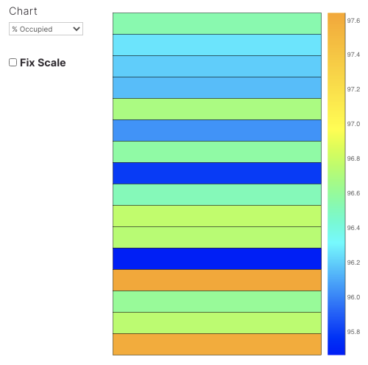
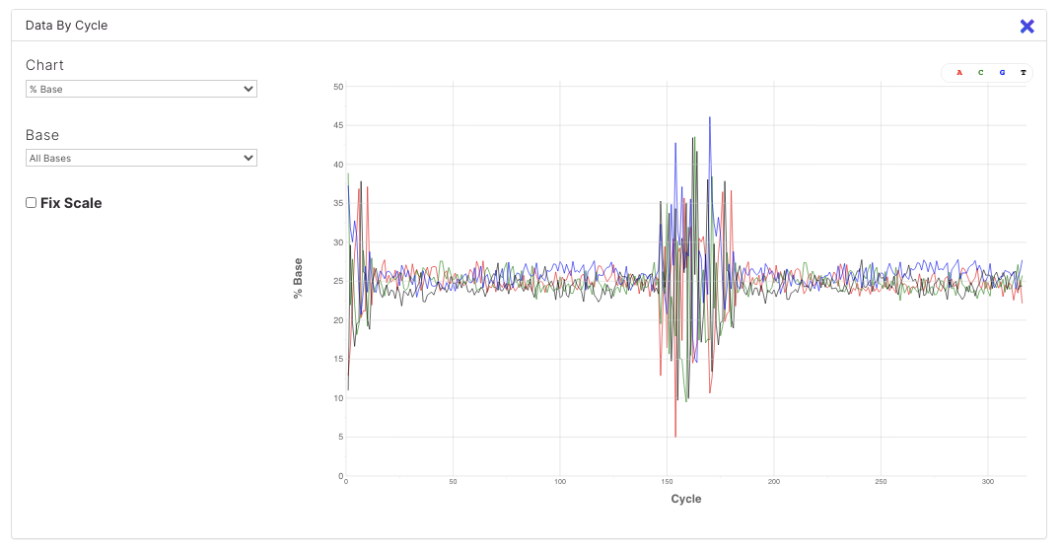
Sequencing run QC
Rapid Response – Revised 07/30/2026

Slide 2
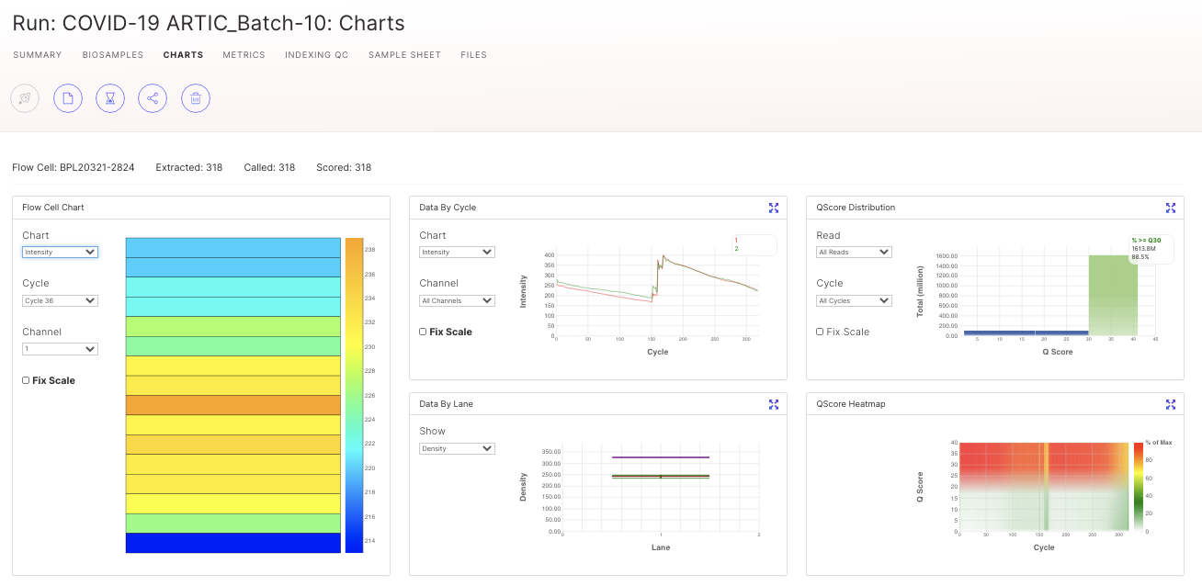
Sequencing Run QC
Did you get the expected amount and quality of sequencing data?
If not, why?

Slide 3
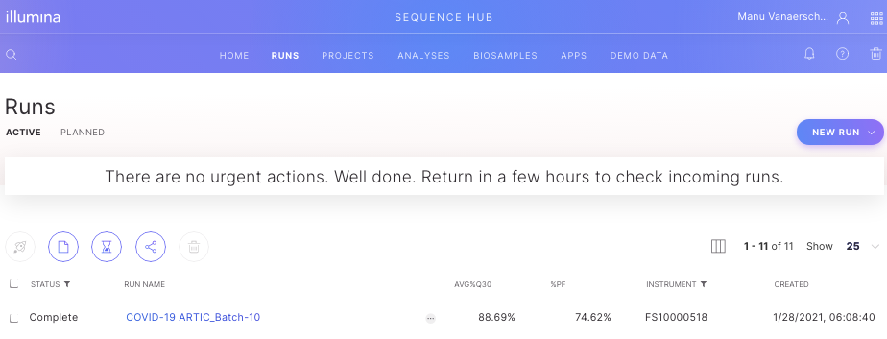
Sequencing Run QC using BaseSpace
After logging into BaseSpace, Click on ‘Runs’ to view a list of all your runs.
Click on a Run Name to see it’s metrics.

Slide 4
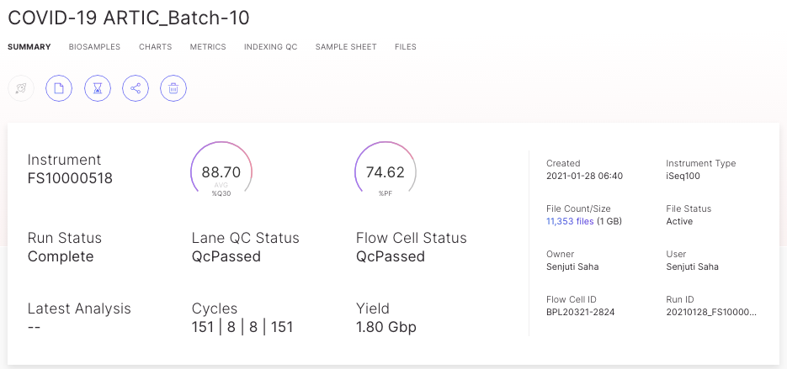
Sequencing Run QC using BaseSpace

Slide 5
AVG%Q30 and %PF
AVG%Q30 = percentage of reads that have bases with an average quality score >Q30
  Ideally AVG%Q30 >90%, but >70% is good too
  If <70%: evaluate why the quality is lower than expected. Possible reasons:
    Overclustering: too much material was loaded on the flow cell
    Adapter dimers: these will yield reads with only ~70bp of good signal, and the rest low quality ‘nothingness’.
%PF = percentage of passed filter reads = reads based on a cluster of a single molecule
  iSeq: Ideally >70%, but >50% is good too
  MiSeq/MiniSeq: Ideally >80%, but >70% is okay too
  If <50%/<70%, check for indications of overclustering or underclustering
Notes:
The filter used to determing %PF is the Chastity filter. This works by calculating the ratio of the highest base intensity to the sum of the 1st and 2nd highest, anything less than 0.6 is filtered out. If a cluster was formed from a single-molecule then the chastity score will be 1; if it were formed from two molecules the signal would be equal and the chastity score will be 0.5.

Slide 6
QC charts
Click on ‘Charts’ to view the QC charts

Slide 7
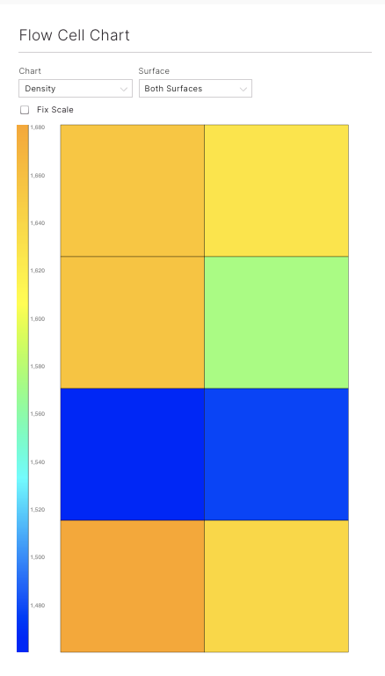

Evaluate clustering for MiSeq
MiSeq
Flow Cell Chart: select Density under ‘Chart’
Optimal Raw cluster density MiSeq:
V2 kits: 1000-1200 K/mm²
V3 kits: 1200-1400 K/mm²
This V3 example shows a raw cluster density ~1600 K/mm²
-> The run was overclustered!
-> lower %PF reads
-> lower yield of PF reads total
Check QC data to see why concentration in nM of final library was underestimated (length overestimated?)

Slide 8
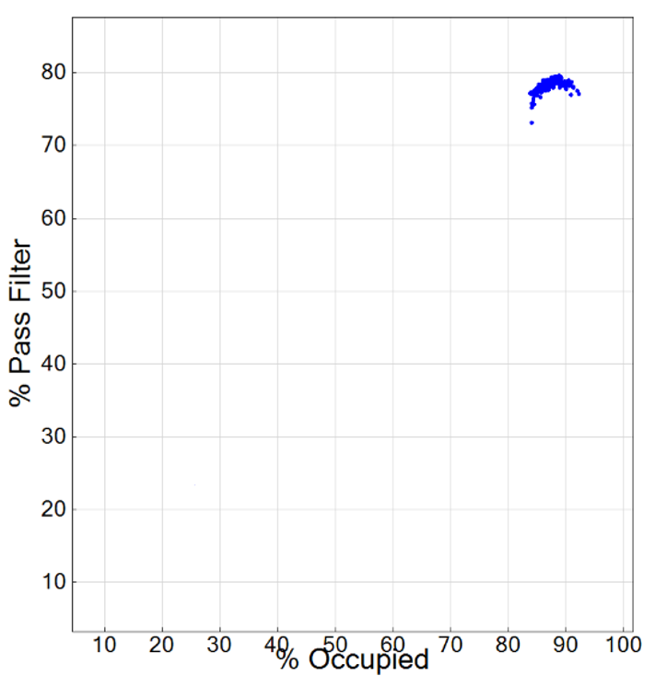
Evaluate clustering for iSeq/NextSeq and other patterned flow cells
In SAV (not Basespace):
Load the run metrics data into SAV and then select the Images tab.
In the Images tab, select Custom Plots
In the Custom Plots window, ensure that the Scatter plot radio button is selected.
In the X Axis Value dropdown menu, select %Occupied
In the Y Axis Value dropdown menu, select % Pass Filter
Calculating %PF: https://knowledge.illumina.com/instrumentation/general/instrumentation-general-reference_material-list/000006309

Slide 9
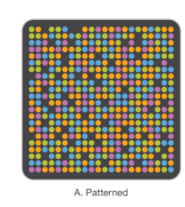
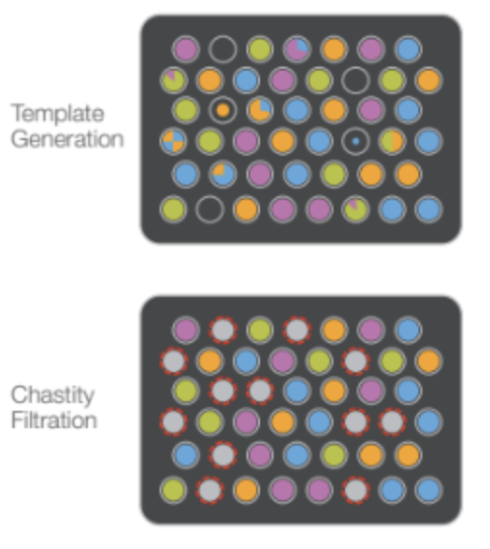
How is % PF calculated?
For patterned flow cells
All nanowells, including empty wells or clusters that may be dim, low quality, or polyclonal are included in the raw cluster count (denominator), which leads to lower %PF values.
Clusters passing chastity filter
Raw cluster count (aka # of spaces in the nanowell)
% PF =
What could cause low %PF?
Clusters are too close to their neighbors
Clusters are empty

Slide 10
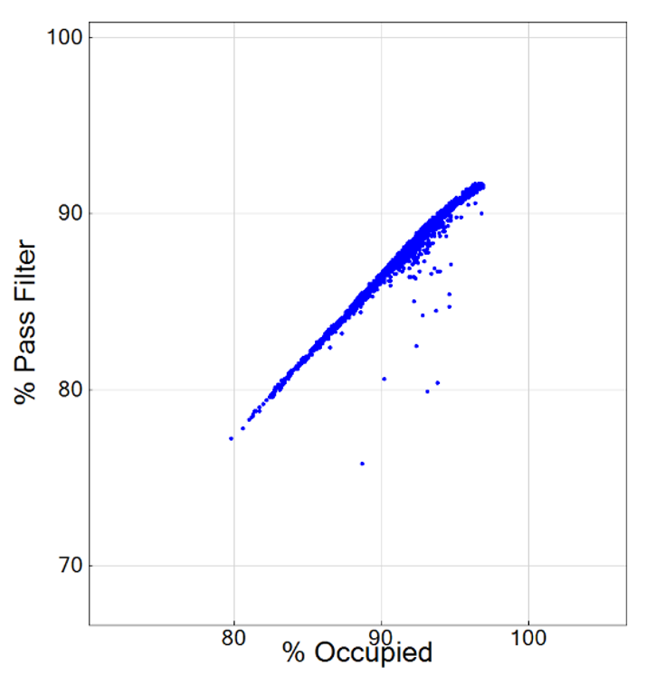
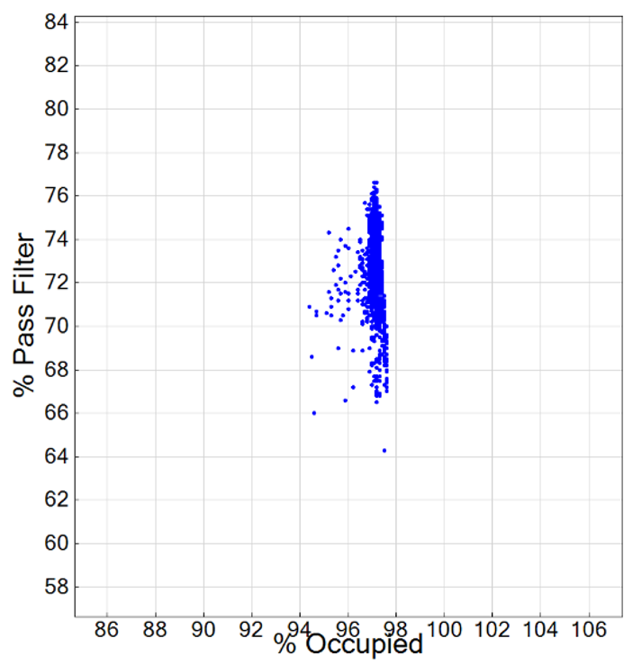
Evaluate clustering with % PF x % Occupied plots
For patterned flow cells
iSeq
NextSeq
Under-clustered
Optimally clustered
Over-clustered
How to make these plots: https://knowledge.illumina.com/instrumentation/general/instrumentation-general-reference_material-list/000002308

Slide 11
Evaluate clustering for iSeq/NextSeq – putting it together
For patterned flow cells
 | %PF | % Occupancy | Q30 | PhiX alignment
Over-loaded | Low (clusters bleed into each other) | High | Low | Lower than expected*
Under-loaded | Low (many clusters are empty) | Low | High | Higher than expected*
* PhiX alignment expected is based on the assumption that the PhiX library size (520bp) is ~the same as your library size
* PhiX must be uncompromised (freeze-thaws, DNase contamination, storage concentration)

Slide 12
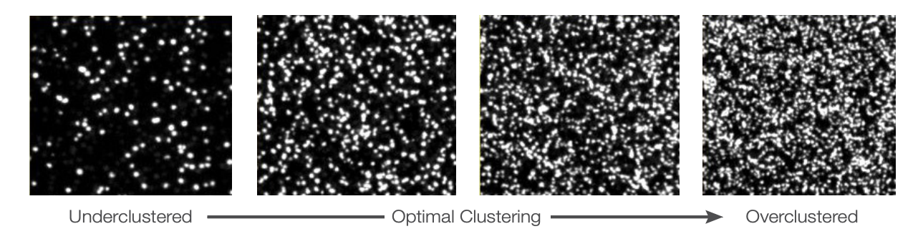
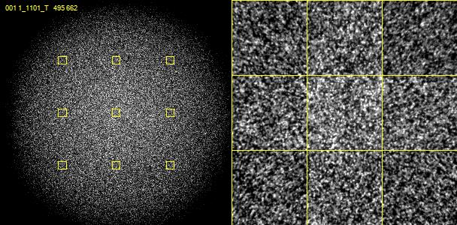
Evaluate clustering by looking at Files/Thumbnail_Images
Illumina examples from here
Tiles also show overclustering of this MiSeq run

Slide 13
Evaluate level of adapter dimers and fragment length
Data by cycle chart: select % Base under ‘Chart’ -> Adapter dimers? Short fragments?
Index ✕2
Read 1 = 150 cycles
Read 2 = 150 cycles

Slide 14
Evaluate level of adapter dimers and fragment length
Data by cycle chart: select % Base under ‘Chart’ -> Adapter dimers? Short fragments?
Variation in beginning of reads is normal
Signal around 25% (if 50%GC content)
Lower sequence diversity of indexes causes larger peaks
Index ✕2
Read 1 = 150 cycles
Read 2 = 150 cycles

Slide 15
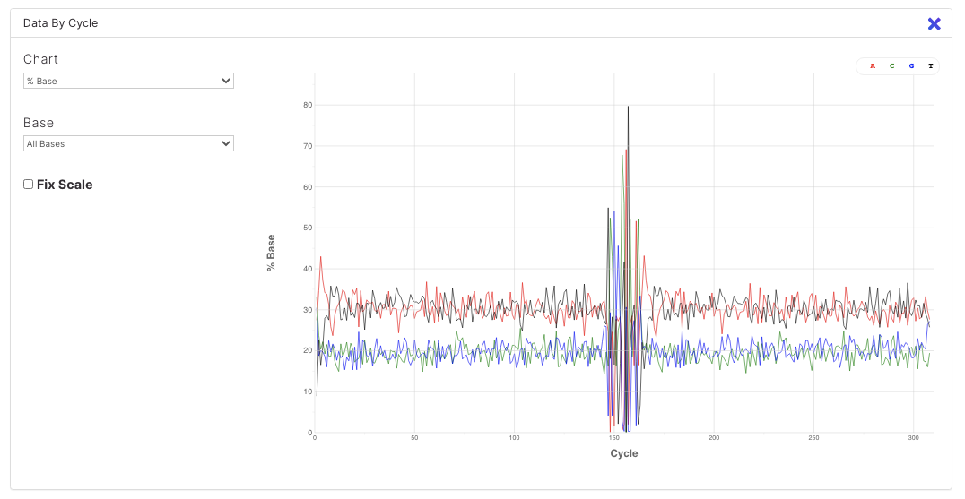
Evaluate level of adapter dimers and fragment length
Average signal for GC and AT can differ based on GC content, but overall GCAT signal average should be 25%

Slide 16
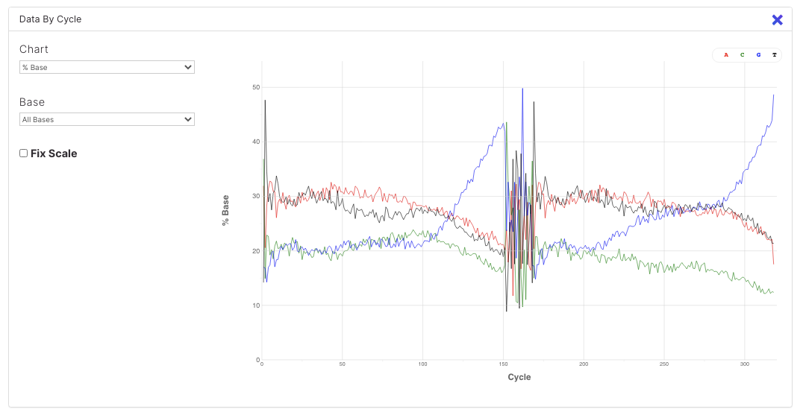
Evaluate level of adapter dimers and fragment length
Issue 1 - short reads: Increase in G signal at end of reads
G is the “dark base” is iSeq , MiniSeq, NextSeq and NovaSeq chemistry.
Continuous increase in G indicates no bases detected for subsequent cycles
Inserts shorter than 150 bp?
Issue with elongation of strands during clustering?
If insert size was indeed shorter than usual (check lib prep QC), reduce fragmentation time for future!
Increase in G signal at end of reads
Note: MiSeq and HiSeq would call an A in case nothing is detected.

Slide 17
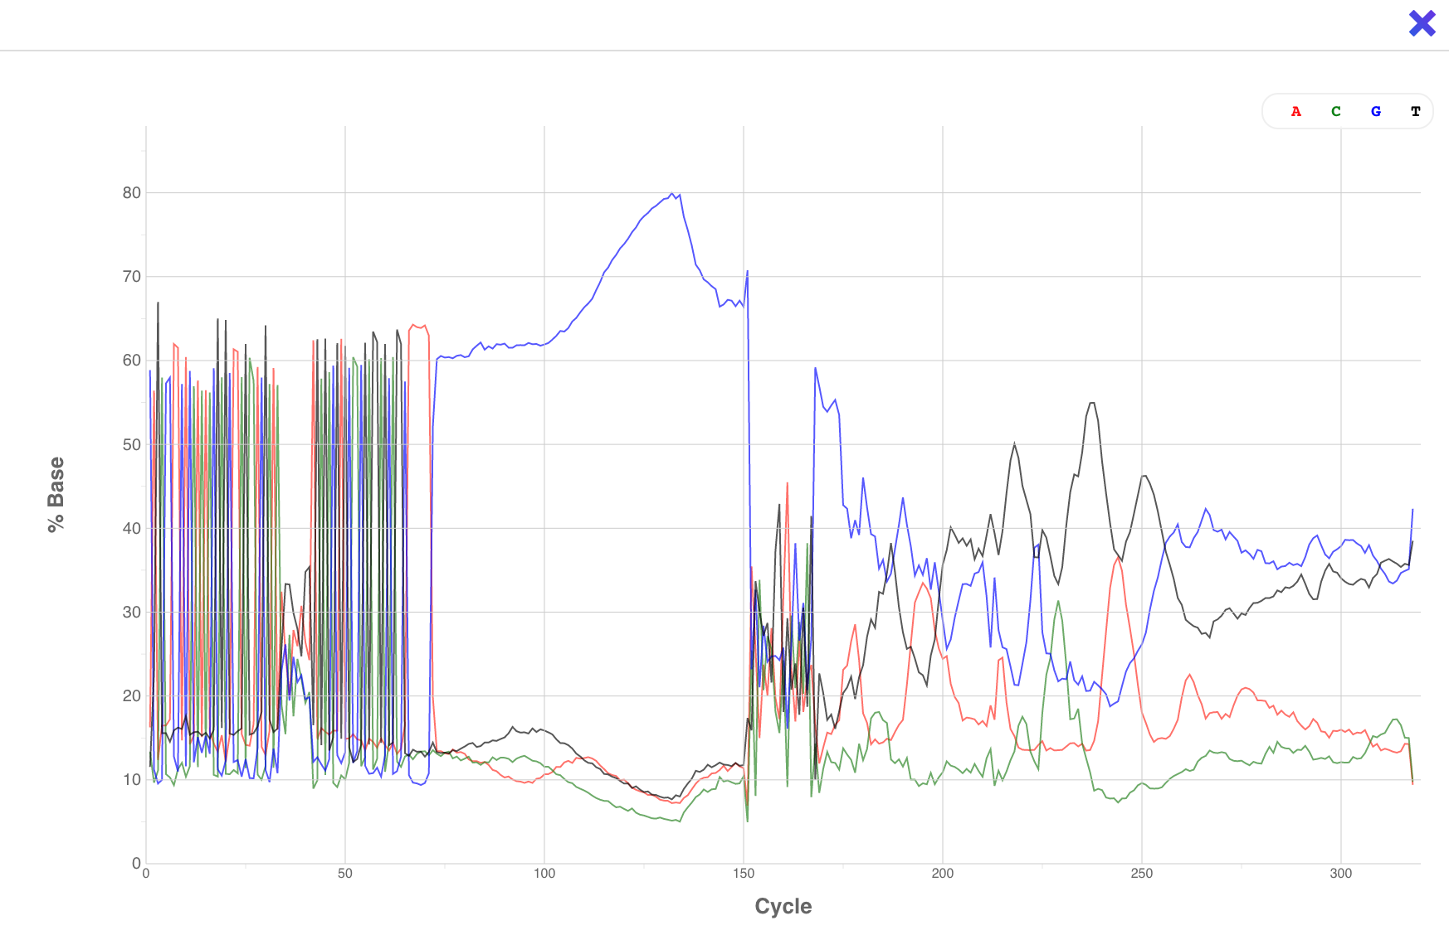
Evaluate level of adapter dimers and fragment length
Issue 2 - adapter dimers: Large peaks for first 70 cycles, and then an increase in G signal (iSeq, MiniSeq, NextSeq, NovaSeq)
Adapter dimers will yield reads with low sequence variation (large peaks) that are about 70 bp long
Adapter dimers are short fragments and thus get preferentially sequenced, taking up valuable sequencing space
Crucial to remove ALL adapter dimers during library prep QC !!
Adapter dimers being sequenced
The first ~30 bases are the first portion of the illumina adapter, followed by heterogeneity from the barcode sequences (8-12 bases), followed by the last ~30 bases of the adapter. Then a large spike in the ‘dark’/no signal base ‘G’.

Slide 18
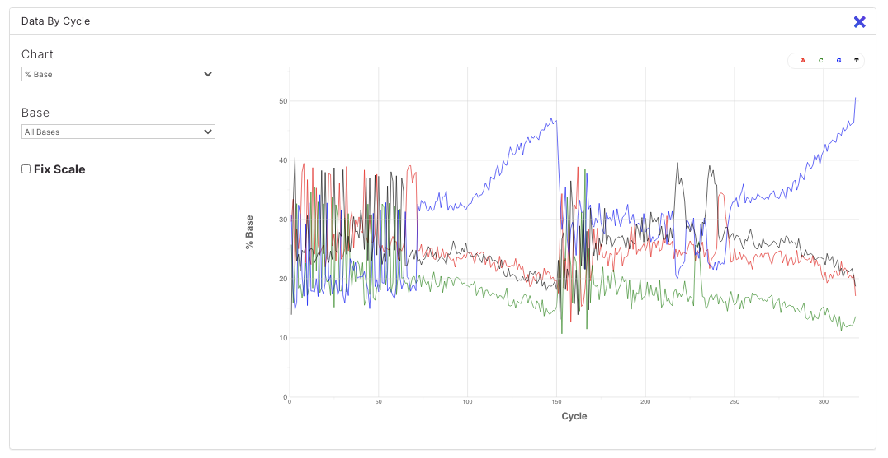
Evaluate level of adapter dimers and fragment length
Issue 3 - adapter dimers and short reads: Large peaks for first 70 cycles followed by more stable signal and then a steady increase in G signal
Adapter dimers will yield reads with low sequence variation (large peaks) that are about 70 bp long
Adapter dimers are short fragments and thus get preferentially sequenced, taking up valuable sequencing space
Crucial to remove ALL adapter dimers during library prep QC !!
Adapter dimers being sequenced
Notes:
The first ~30 bases are the first portion of the illumina adapter, followed by heterogeneity from the barcode sequences (8-12 bases), followed by the last ~30 bases of the adapter. Then a large spike in the ‘dark’/no signal base ‘G’. The graph on the right is closer to the expected % base plots for samples without much adapter dimer.

Slide 19
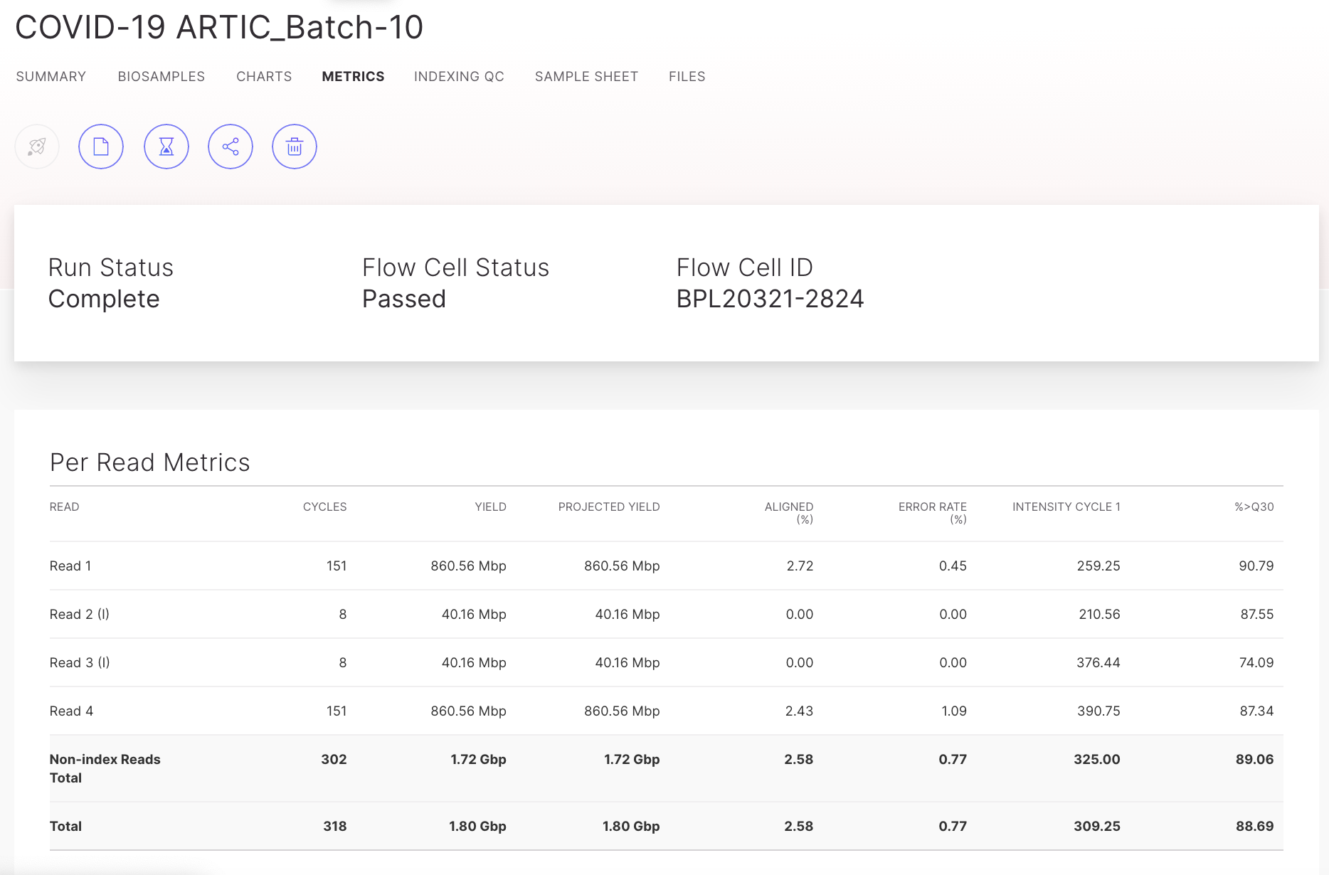
Evaluate error rate based on PhiX

Slide 20
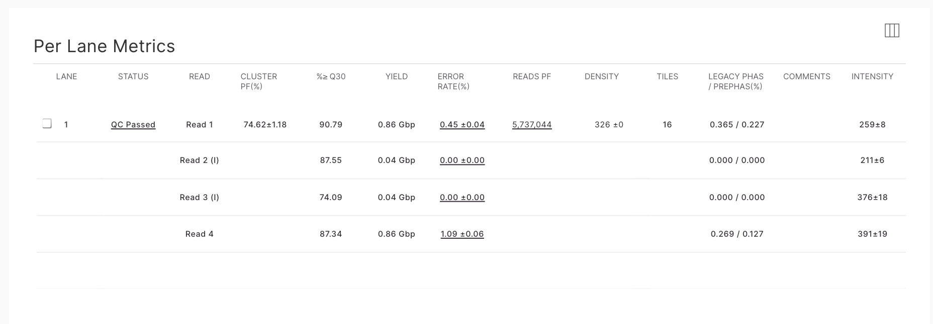
Evaluate sequencing data yield
Number of paired end reads that were generated
Scroll down to ‘Per Lane Metrics’

Slide 21
Evaluate sequencing metrics
On the ‘Metrics’ page (if using PhiX)
Per Read Metrics:
% Aligned (PhiX): should be close to % of PhiX that you spiked in.
  If it’s higher, PhiX outcompeted your library, meaning you put less library in than you thought (double check your pooling and quantification calculations).
  If it’s lower than expected, small fragments like adapter dimers might have outcompeted PhiX AND/OR you underestimated the quantity of material in your sample (added way more than you thought, double check your quantification data).
Error rate % (PhiX): should be less than 1%.
Per Lane Metrics:
Reads PF: number of passed filter reads that were generated in this run. This should be close to (or over) the minimum number of guaranteed reads that your sequencer is advertised to generate. If lower, you probably under- or overclustered. Check your quantification calculations and adjust the loading concentration if needed.
Notes:
In case of high % undetermined reads and/or missing samples, refer to the file ‘DemuxSummaryF1L1.txt’, found in the demultiplexing folder to identify possible incorrect sample barcodes.

Slide 22
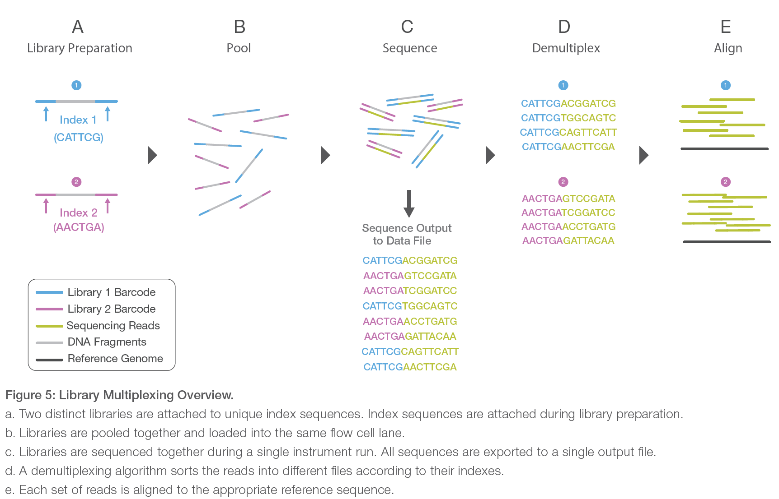
Evaluate demultiplexing
Adapted from Illumina.com
Notes:
From: Illumina_sequencing_introduction.pdf

Slide 23

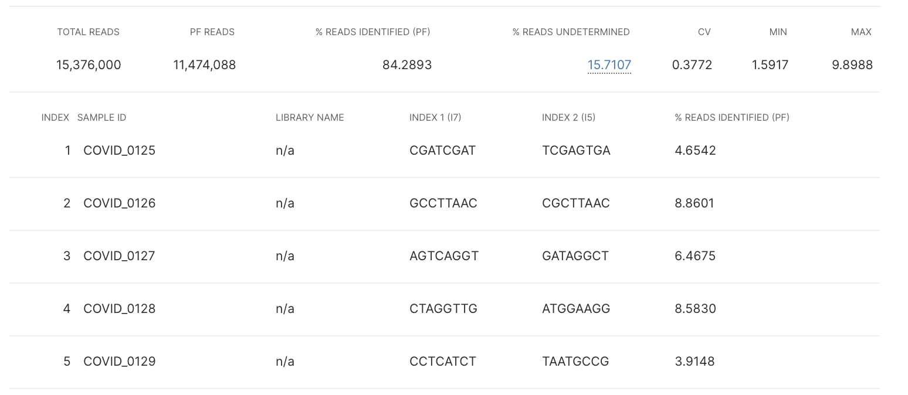
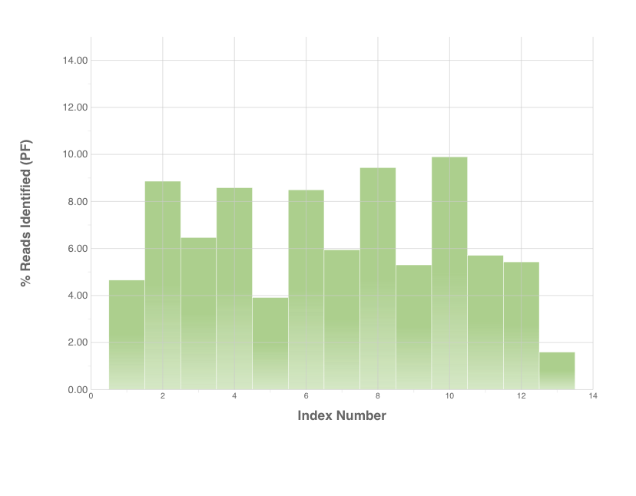
Evaluate demultiplexing
If correctly pooled, all samples should have more or less the same # of reads assigned
...
...
...
...
Notes:
In case of high % undetermined reads and/or missing samples, refer to the file ‘DemuxSummaryF1L1.txt’, found in the demultiplexing folder to identify possible incorrect sample barcodes

Slide 24
Evaluate demultiplexing
On the ‘Indexing QC’ page:
% read identified = reads with identified barcodes: should be >80% (the higher the better). If this % is low, you should check to make sure your sample sheet assigned the correct index/barcode sequences for each sample.
% reads undetermined = reads without an associated known barcode. If this % is high, you should check to make sure your sample sheet was correct.
PF reads: this number details the amount of (unpaired) single end reads. This number is always double than your true amount of paired-end reads shown on the ‘Metrics’ page.
Notes:
In case of high % undetermined reads and/or missing samples, refer to the file ‘DemuxSummaryF1L1.txt’, found in the demultiplexing folder to identify possible incorrect sample barcodes.

Slide 25
How to troubleshoot demux in BaseSpace

Slide 26
Locating and interpreting the demux file to troubleshoot failed demultiplexing or missing samples
A high % of undetermined reads and missing samples (samples with no reads assigned) indicate an issue with demultiplexing!
  Double check the sample sheet to verify if the correct barcodes were assigned to each sample.
  Look at the barcodes sequences identified for ‘undetermined reads’ listed in DemuxSummaryF1L1.txt, if there is barcode combination (paired end) that occured in a high number of reads, it might be an unidentified sample.
    In Basespace, go to Summary page of run -> Click on blue “FASTQ Generation of….” under Latest analysis, scroll down to Logs -> click on “View files”.
Info on finding troubleshooting and finding the demux file in BaseSpace here
-How to edit sample sheet and requeue in Basespace here
Info on finding troubleshooting and finding the demux file using Local Run Manager here
Info on finding troubleshooting and finding the demux file using MiSeq Reporter here
-How to edit sample sheet and requeue using MiSeq Reporter here

Slide 27
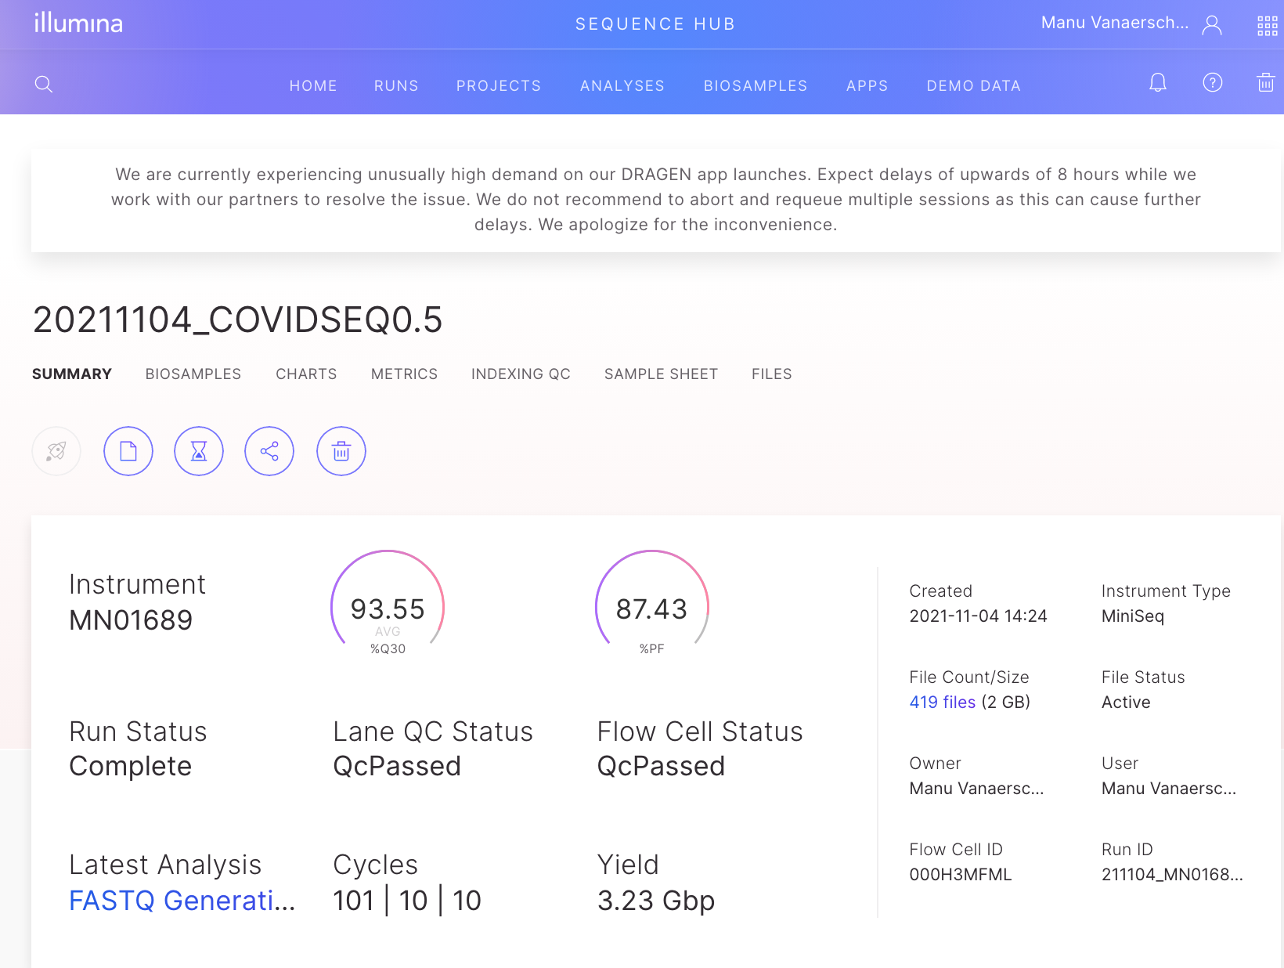
On the summary page of the run, click on FastQ Generation under Latest Analysis

Slide 28
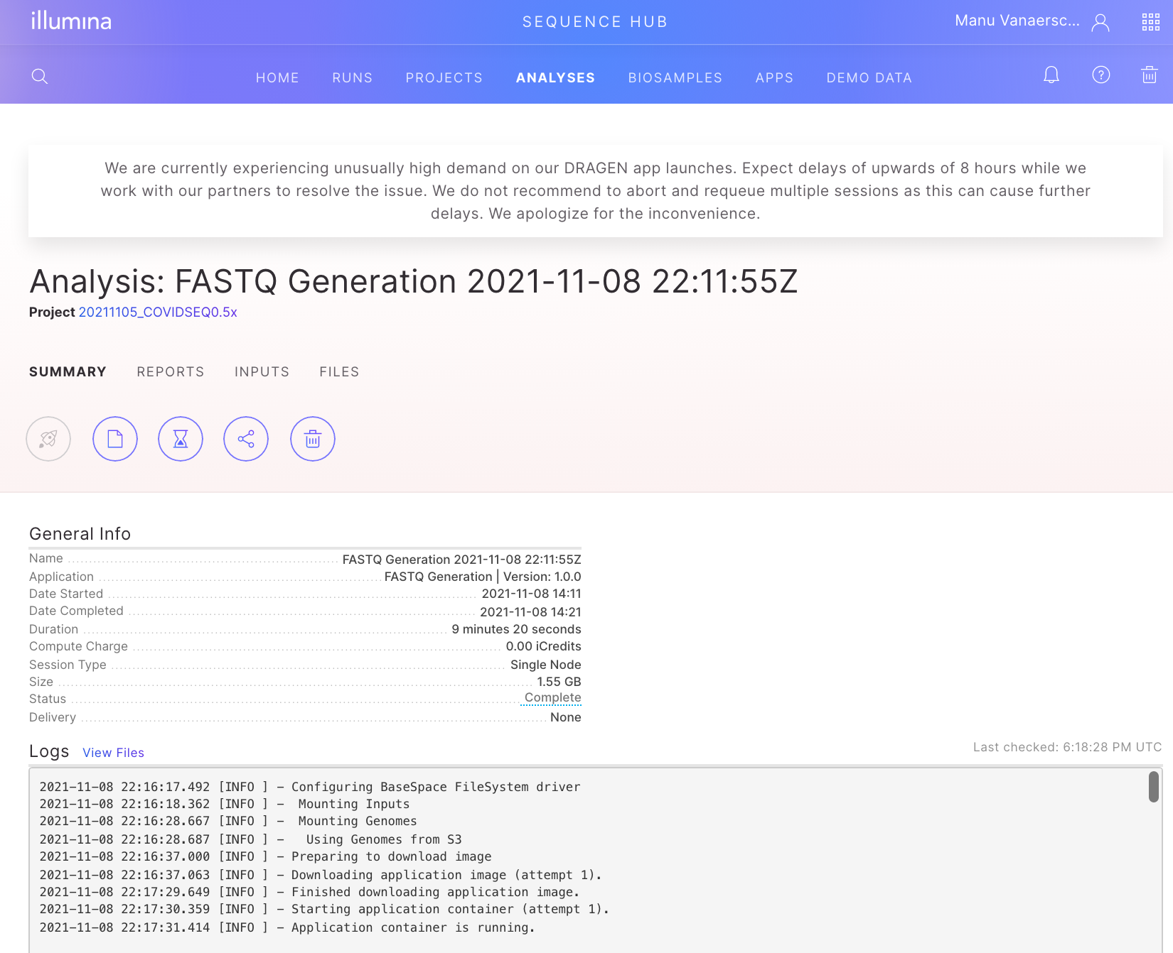
On the summary page of the FASTQ analysis, click on View Files next to Logs.

Slide 29
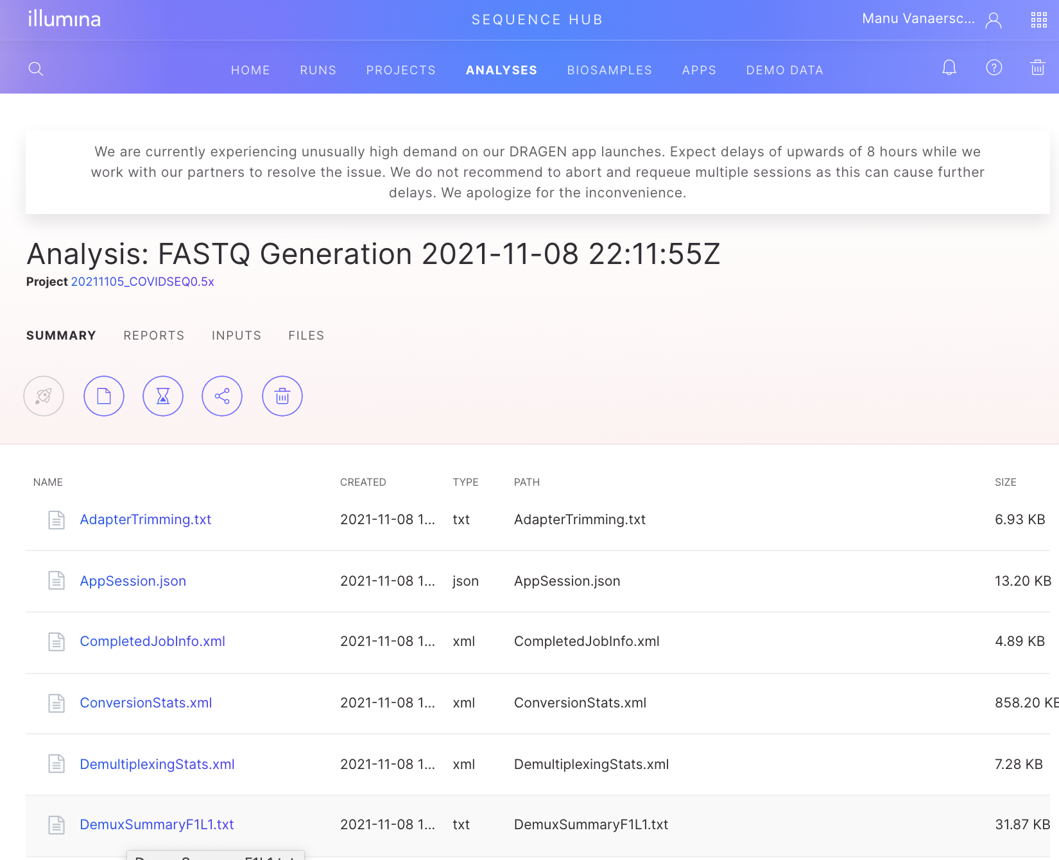
Click on the DemuxSummaryF1L1.txt file to download it.

Slide 30
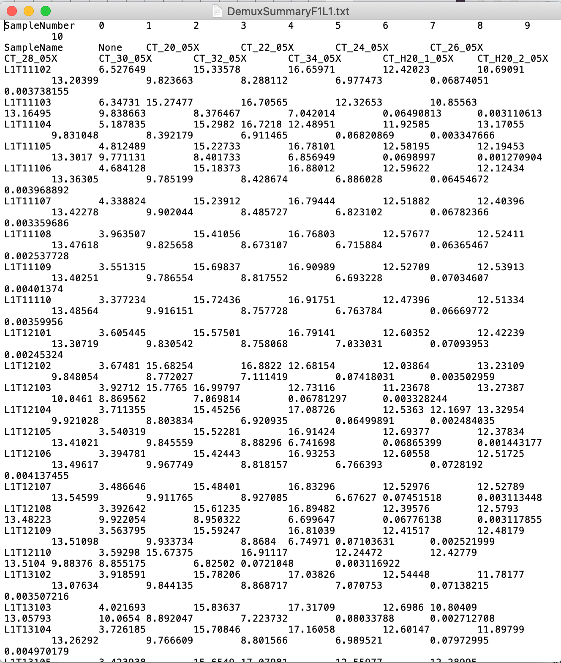
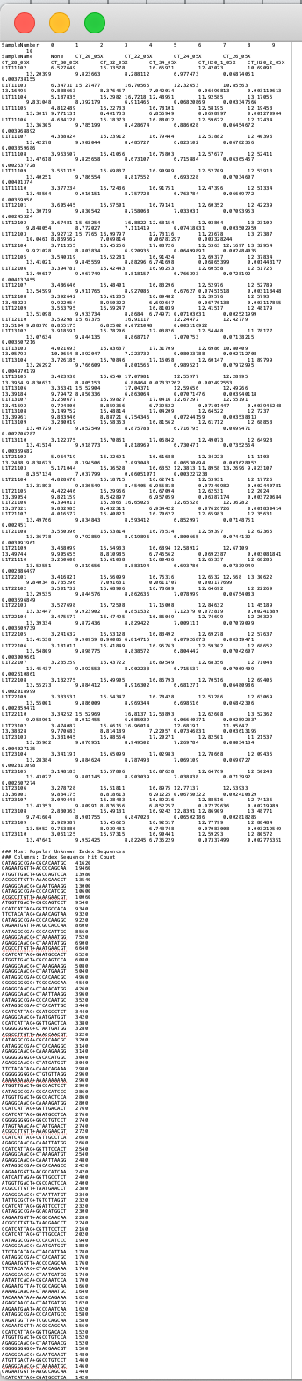
Open the DemuxSummaryF1L1.txt file in a text editor (e.g. Notepad, TextEdit, SublimeText)
How it looks when you open the file
Scroll down to the section with header
“### Most Popular Unknown Index Sequences”

Slide 31
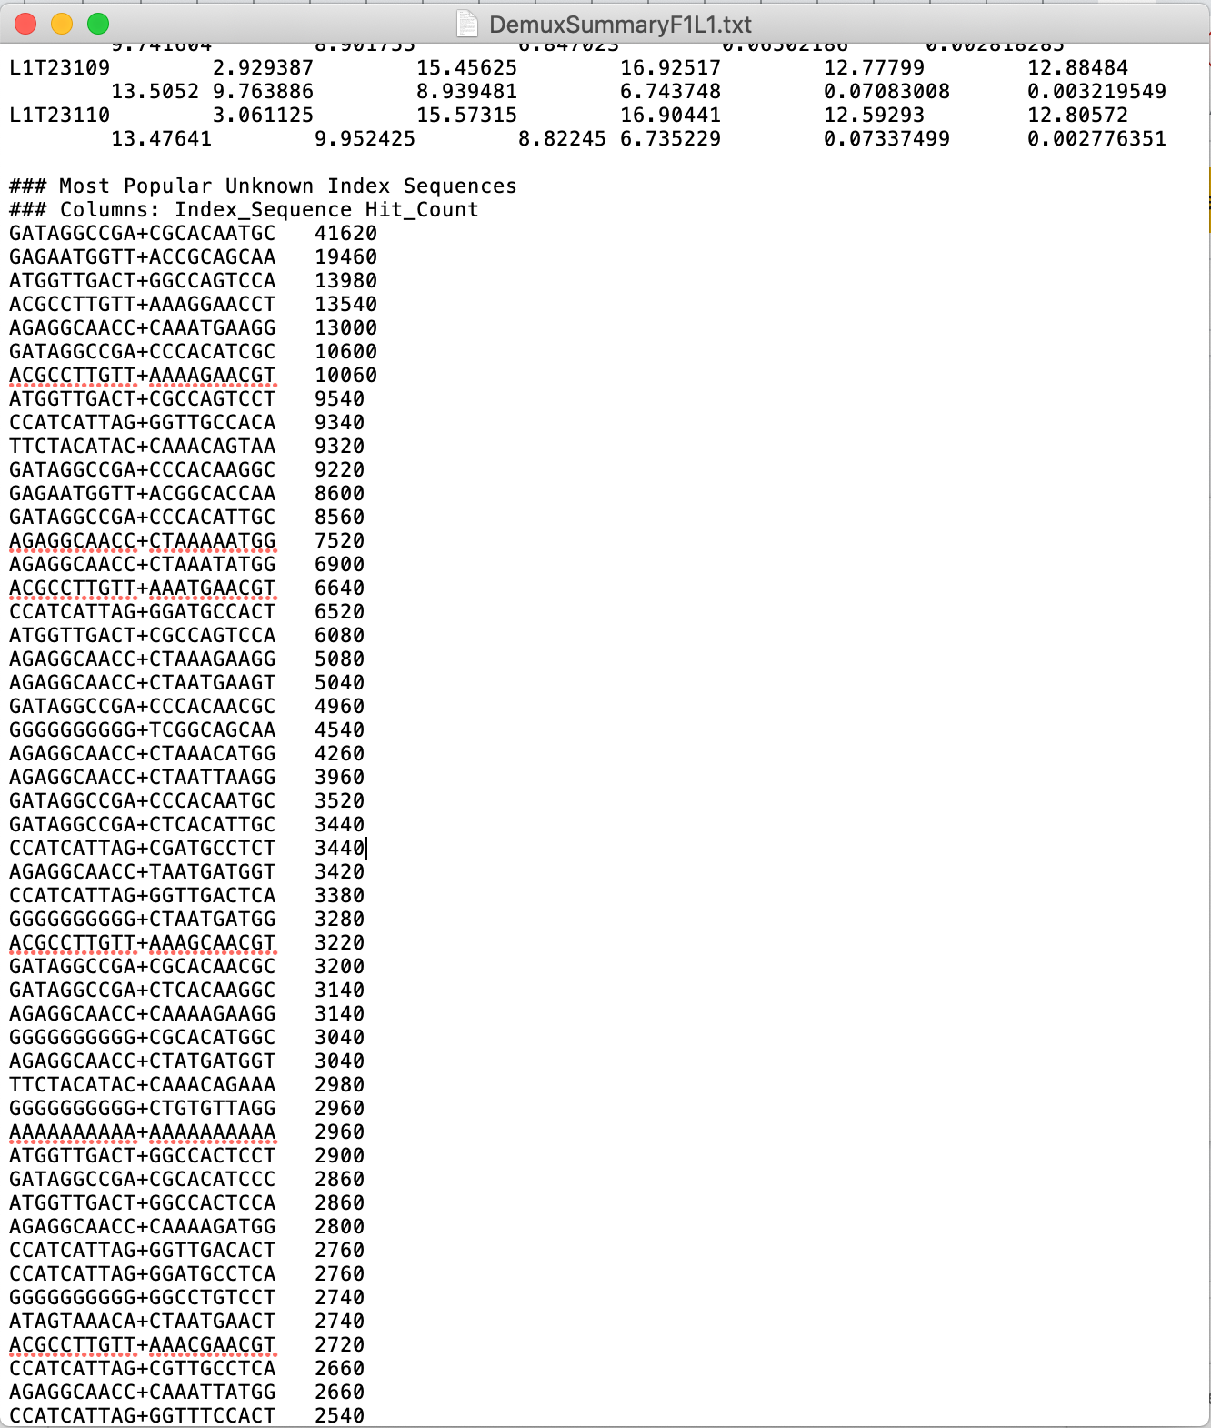
Inspect the top barcode combinations listed under ###Most Popular Unknown Index Sequences
Hit_Count = the number of reads that have the listed barcode combination (NNNNNNNN….+NNNNNNNN….)
Focus on barcode combinations that have a high Hit_Count!
Common issues:
Barcode/index sequence in sample sheet was (not) reverse complemented
Too many index cycles performed -> extra nucleotides were added to the barcodes/indexes. Identify which nucleotides in this list and update sample sheet for requeuing fastq analysis.
When the samplesheet is corrected/updated -> requeue for demux

Slide 32
How to requeue demux in BaseSpace

Slide 33
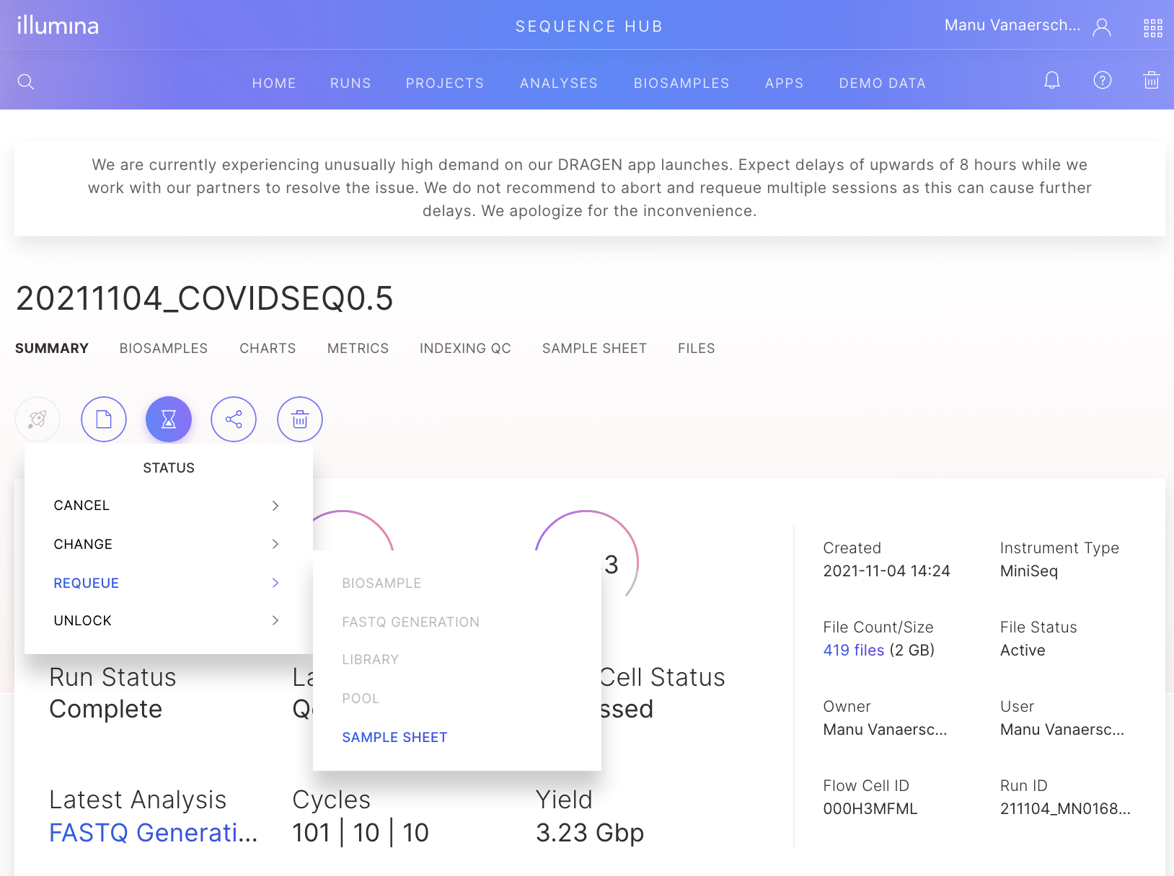
On the Summary page of the run, click on the hourglass, select Requeue and then select Sample Sheet

Slide 34
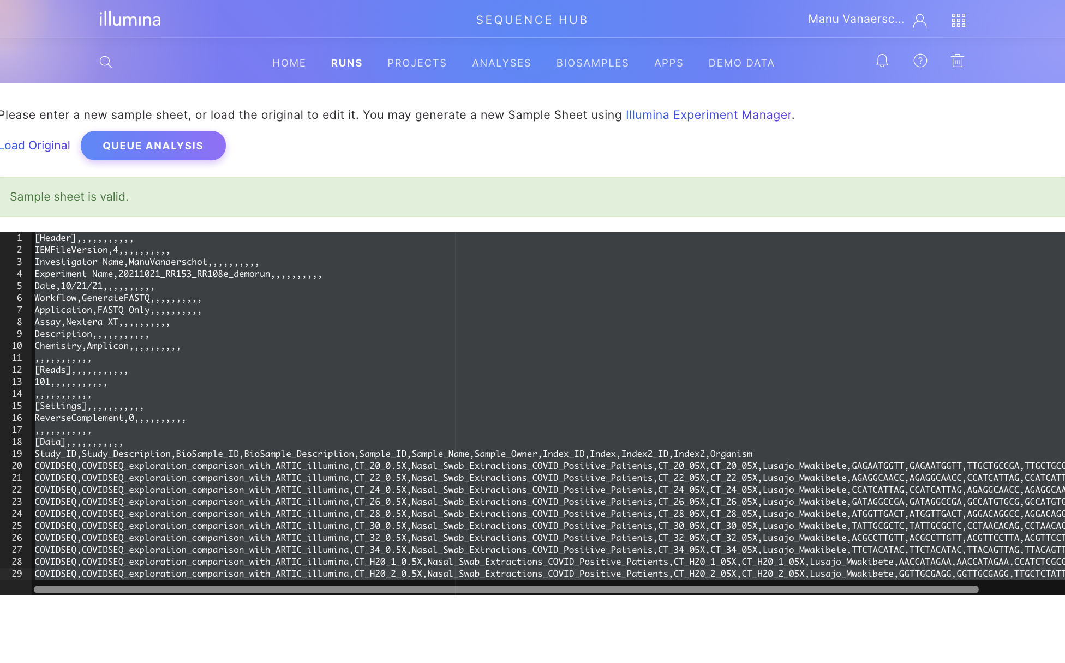
Click with your cursor in the black part of the screen and select everything (ctrl+A or cmd+A)

Slide 35
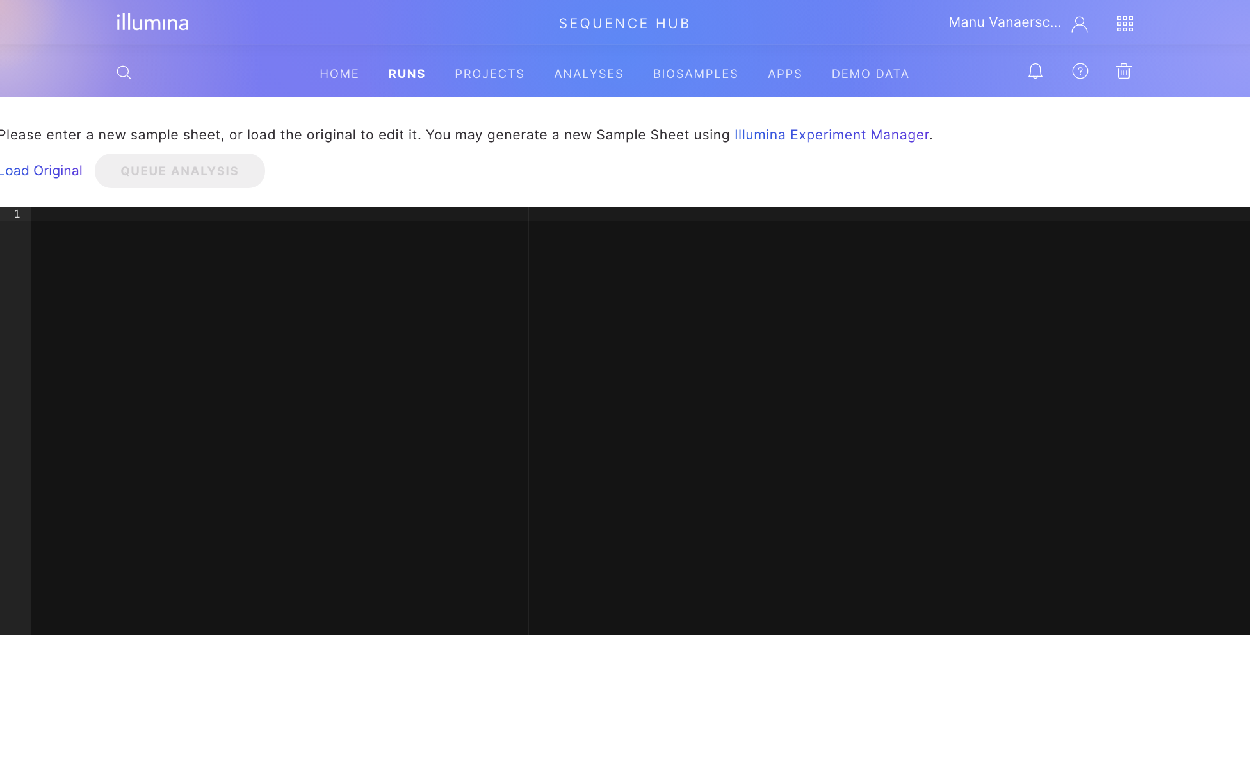
Click delete to delete the content of the sample sheet

Slide 36
Open your corrected sample sheet (saved as a .csv file) in a text editor such as Notepad or TextEdit, select all of its content (ctrl+A or cmd+A) and copy it into the black screen.
A green banner saying “Sample sheet is valid” will re-appear automatically if the copied sample sheet is valid. If not, make sure there are no columns or data fields missing in your sample sheet and that you indeed copied the full contents of the sample sheet into the field.
If sample sheet was valid, click on the blue button for Queue Analysis

Slide 37
What if my sequencer is not connected to the internet?
(a guide to SAV)

Slide 38
If your sequencer is not connected to the internet…
Your run cannot be uploaded / viewed on Basespace
but…
You can use the Illumina app: Sequencing Analysis Viewer (SAV)

Slide 39
Illumina Sequencing Analysis Viewer (SAV)
Illumina has a software app (Sequencing Analysis Viewer)
You can download the app and use it to visualize the metrics/data included in the run folder, just as you would use Basespace
There are a few short training videos on the SAV website that we recommend
SAV user guide can be found here

Slide 40
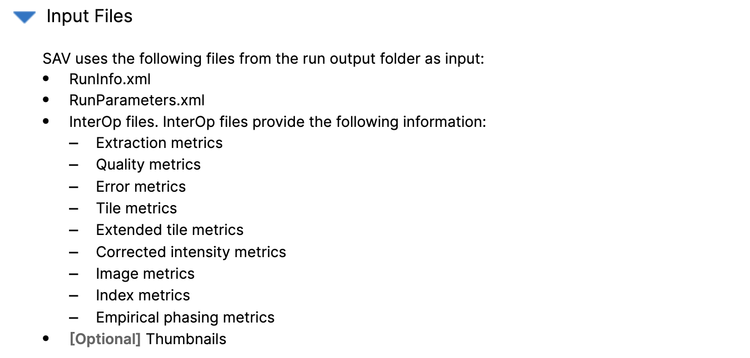
Retrieve your run files from the Illumina sequencer
You will need to transfer the following files from the sequencer to your computer where you are using SAV

Slide 41
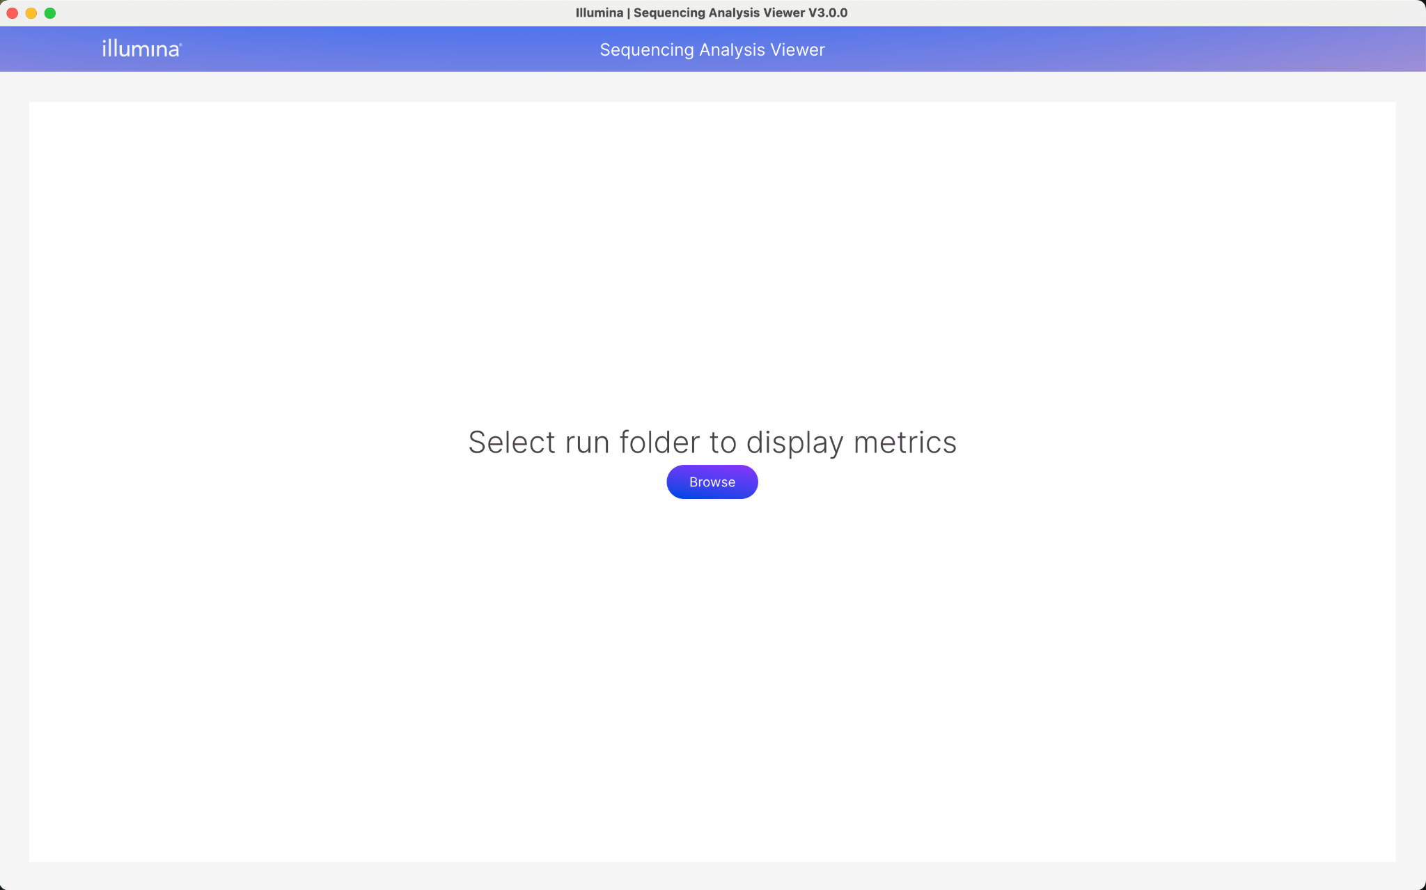
2. Open run in Sequence Analysis Viewer
After retrieving your sequencing run files and opening Sequence Analysis Viewer, click on ‘Browse’ and select the appropriate Run folder to view it’s metrics.

Slide 42
3. Follow the earlier slides in this deck for step by step QC
The process of reviewing QC in SAV is the same as the process you would follow in Basespace

Slide 43
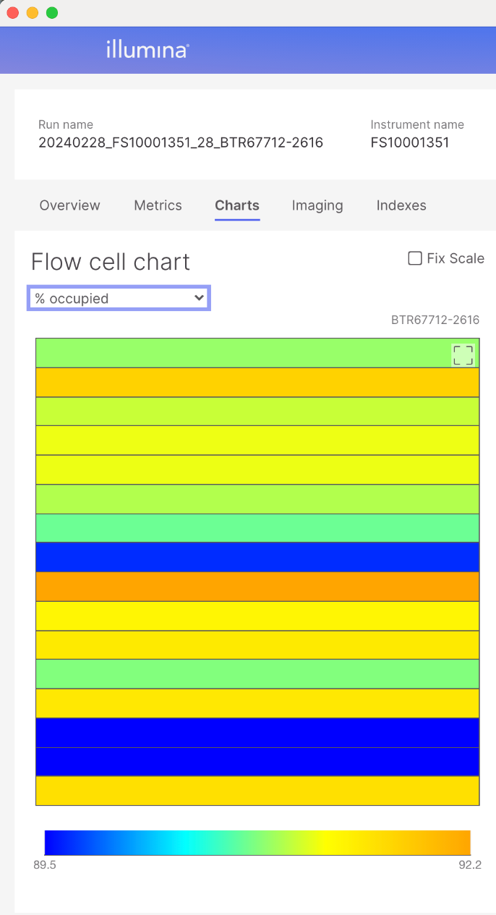
How to QC a sequencing run in Sequence Analysis Viewer
For iSeq runs (patterned flow cell):
In the Flow Cell Chart, click on the arrow to display the ‘% Occupied’ data instead of ‘Intensity’.
Determine if the optimal amount of library was loaded onto the flow cell. Are there any signs of over/under clustering?
The % Occupied ranges here from 71 to 76. This indicates minor underclustering. This does not necessarily affect sequence quality, but it does reduce the maximum yield of data that can be obtained from a sequencing run. For the next sequencing run the researchers can load more material on the flow cell (provided that the same quantification protocol is being used) to generate more sequencing data from a single run .

Slide 44
How to QC a sequencing run in Sequence Analysis Viewer
For MiSeq / MiniSeq runs (unpatterned flow cells):
In the Flow Cell Chart, click on the arrow to display the ‘Density’ data instead of ‘Intensity’.
Determine if the optimal amount of library was loaded onto the flow cell. Are there any signs of over/under clustering?
The optimal Density ranges are dependent on the flow cell / sequencer used. View Illumina’s recommendations for cluster density here.

Slide 45
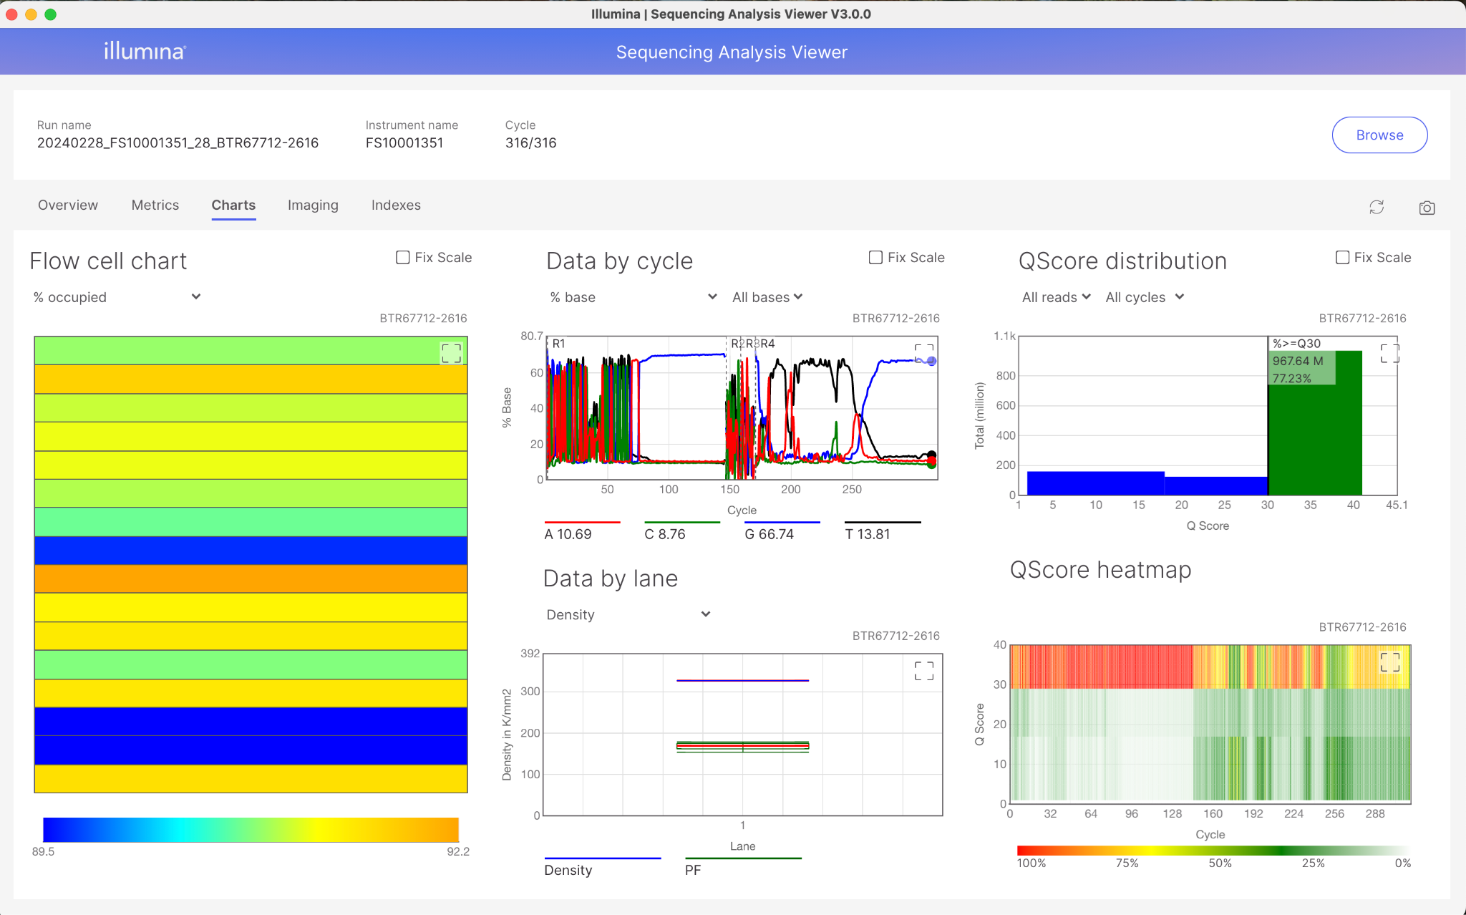
How to QC a sequencing run in Sequence Analysis Viewer
Click the square to expand the plot of interest

Slide 46
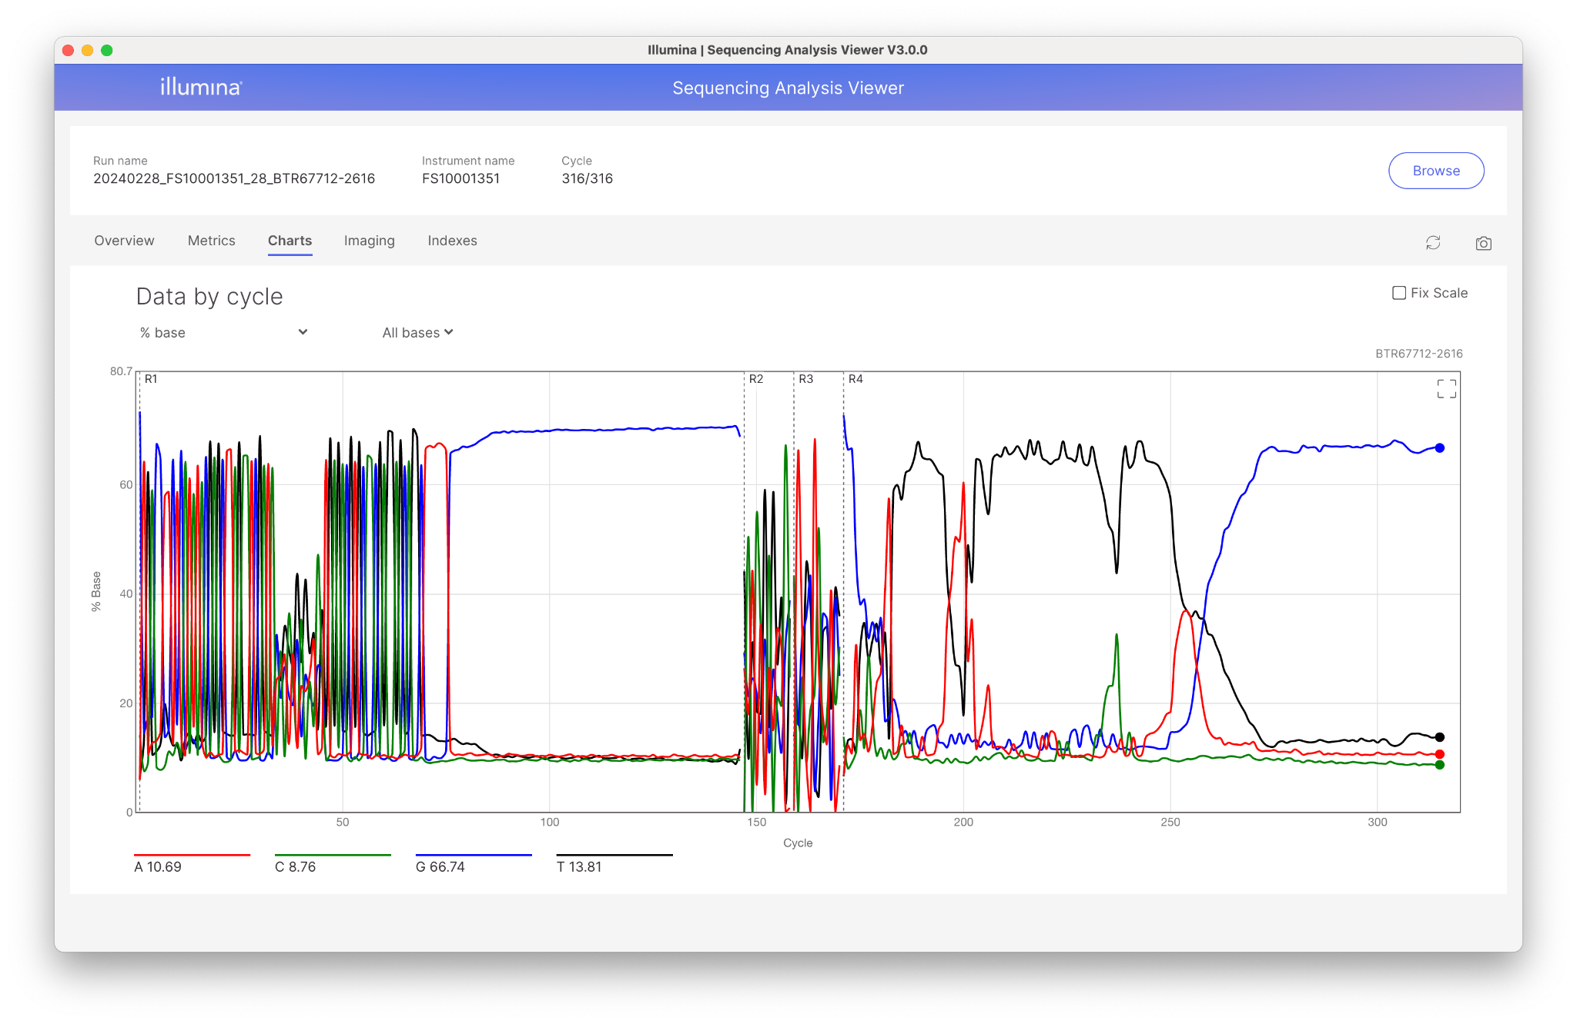
How to QC a sequencing run in Sequence Analysis Viewer
In the ‘Data by Cycle’ graph, select ‘% Base’ to determine if you had any adapter dimers, short fragments or potentially other issues.

Slide 47
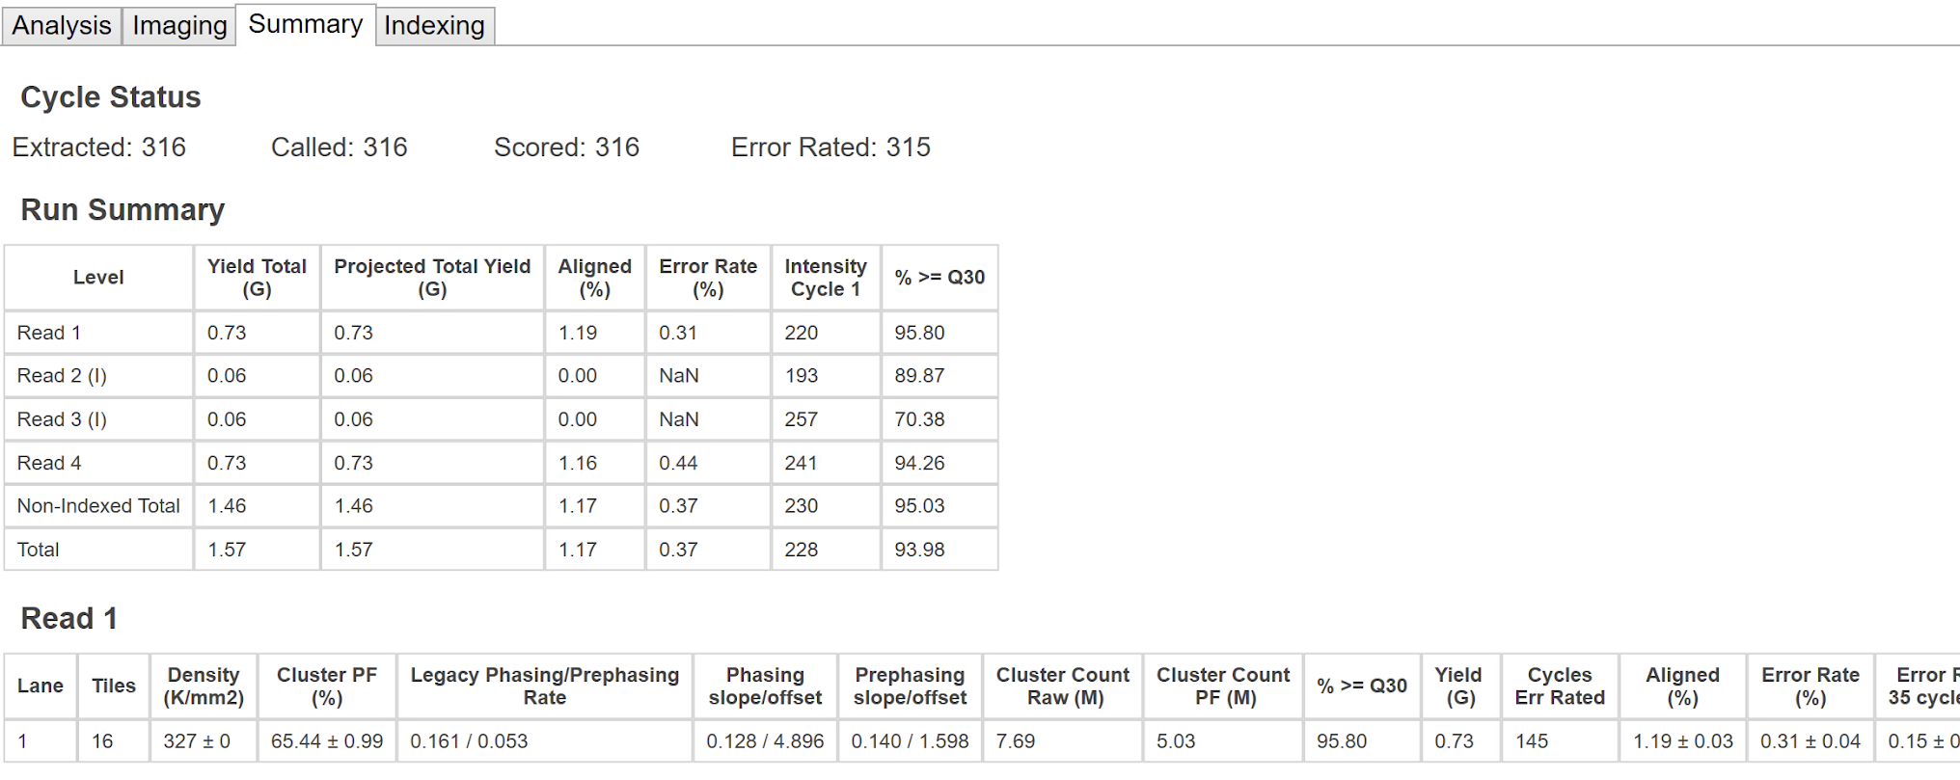
How to QC a sequencing run in Sequence Analysis Viewer
Click on the ‘Summary’ tab to view how many reads were generated, and if the % aligned and the error rate are within the expected range.
% aligned should be similar to %PhiX that was spiked in
Error rate (%) should be <1.0
Cluster Count PF (M) shows how many paired-end passed filter reads were generated (in this case 5.03 million PF reads)

Slide 48
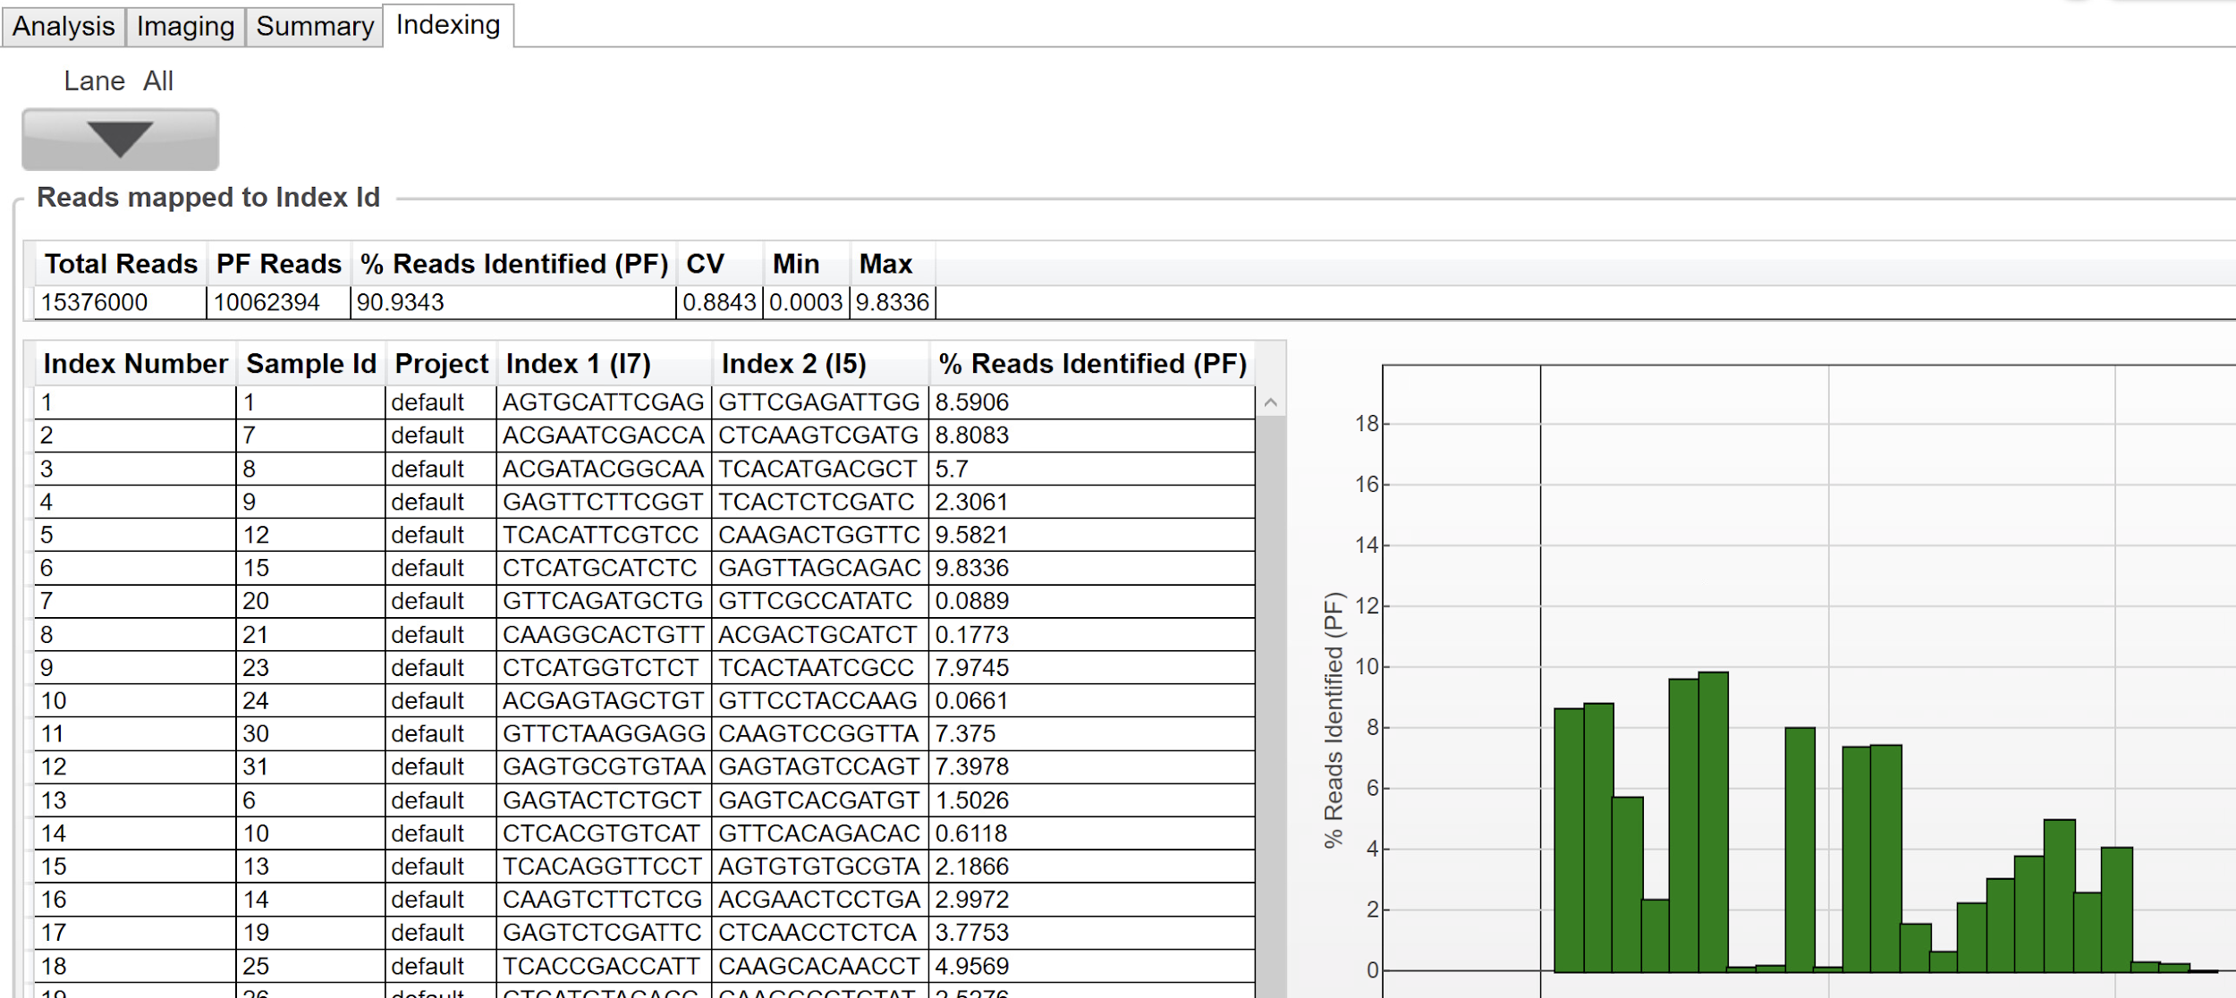
How to QC a sequencing run in Sequence Analysis Viewer
Click on the ‘Indexing’ tab to view metrics on demultiplexing.
% Undetermined reads = 100 – ‘%Reads Identified (PF)’
(= 9.07% in this example)
Check if all samples are equally represented (and none are missing)
Notes:
Remember that the # of PF reads shown in this view is the number of unpaired reads. Divide this number by 2 and it will be identical to the number of paired-end reads (or clusters) shown on the Summary tab.

